Slide 1
Explicit Interaction Model towards Text Classification
[ In-progress Report ]
Cunxiao Du, Zhaozheng Chen, Fuli Feng,
Lei Zhu, Tian Gan, Liqiang NiePiotr
(AAAI ‘19)
Kang Cho
chokang92 @ korea.ac.kr
Data Intelligence Lab, Korea University
2019.10.30

Slide 2
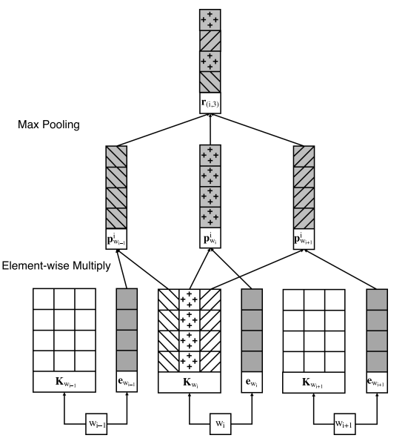
Previous Work
[Region Embedding]
Notes:
COMMUNICATION / COMMUNICATIVE

Slide 3



Previous Work
[Region Embedding]
Text-level representation
SUM
〮 〮 〮
$$Word_{1}$$
$$Word_{2}$$
$$Word_{n}$$
Notes:
COMMUNICATION / COMMUNICATIVE

Slide 4
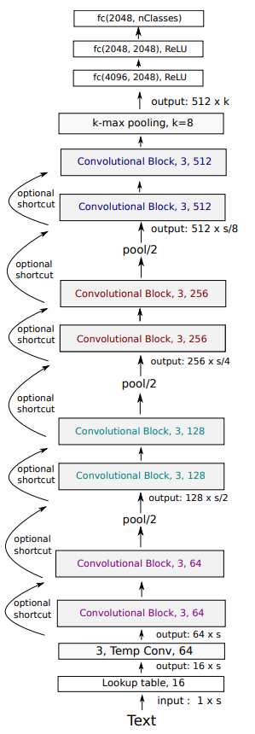
Previous Work
[VDCNN]
Notes:
COMMUNICATION / COMMUNICATIVE

Slide 5
Previous Work
[VDCNN]
Character-level representation
W h a t ㆍㆍㆍ n .
The characters are combined to form N-grams, words, and phrase which are helpful in classification.
Notes:
COMMUNICATION / COMMUNICATIVE

Slide 6



Previous Work
[ Text-level ]
[ Character-level ]
Text-level representation
W h a t ㆍㆍㆍ n .
SUM
It’s difficult to interpret which words and classes were related.
〮 〮 〮
$$Word_{1}$$
$$Word_{2}$$
$$Word_{n}$$
Notes:
COMMUNICATION / COMMUNICATIVE

Slide 7
Previous Work
[ Text-level ]
[ Character-level ]
Text-level representation
W h a t ㆍㆍㆍ n .
SUM
It’s difficult to interpret which words and classes were related.
〮 〮 〮
Can’t calculate
the relationship score !
$$Word_{1}$$
$$Word_{2}$$
$$Word_{n}$$
Notes:
COMMUNICATION / COMMUNICATIVE

Slide 8
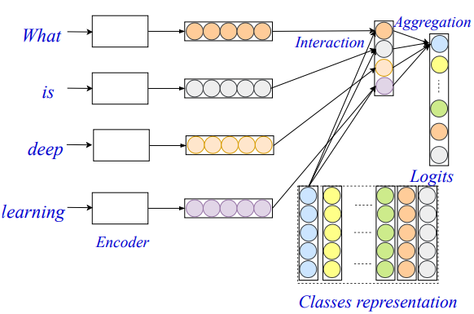
Model
[EXAM model]
Word-level Encoder
First component projects the input text
into a word-level representation.
Interaction Layer
Second component computes the interaction signals between the words and classes.
Aggregation Layer
Third component aggregate the interaction signals for each class and
make the final predictions.

Slide 9
Model
[EXAM model]
Word-level Encoder
First component projects the input text
into a word-level representation.
Interaction Layer
Second component computes the interaction signals between the words and classes.
Aggregation Layer
Third component aggregate the interaction signals for each class and
make the final predictions.

Slide 10
Model
[EXAM model]
Word-level Encoder
First component projects the input text
into a word-level representation.
Interaction Layer
Second component computes the interaction signals between the words and classes.
Aggregation Layer
Third component aggregate the interaction signals for each class and
make the final predictions.

Slide 11
Model
[EXAM model]
Word-level Encoder
First component projects the input text
into a word-level representation.
Interaction Layer
Second component computes the interaction signals between the words and classes.
Aggregation Layer
Third component aggregate the interaction signals for each class and
make the final predictions.

Slide 12
Model
[EXAM model]
Word representation
The
movie
is
funny
.

Slide 13
Model
[EXAM model]
Word representation
The
movie
is
funny
.
Class representation
Class :
#1 #2 #3

Slide 14
Model
[EXAM model]
#1 #2 #3
Word representation
The
The
movie
movie
is
is
funny
funny
.
.
Interaction
Class representation
Class :
#1 #2 #3

Slide 15
Model
[EXAM model]
Relationship between
word “The” and Class “#1”
#1 #2 #3
Word representation
The
The
movie
movie
is
is
funny
funny
.
.
Interaction
Class representation
Class :
#1 #2 #3

Slide 16
Model
[EXAM model]
#1 #2 #3
Word representation
Relationship between
word “movie” and Class “#1”
The
The
movie
movie
is
is
funny
funny
.
.
Interaction
Class representation
Class :
#1 #2 #3

Slide 17
Model
[EXAM model]
#1 #2 #3
Word representation
The
The
Relationship between
word “is” and Class “#1”
movie
movie
is
is
funny
funny
.
.
Interaction
Class representation
Class :
#1 #2 #3

Slide 18
Model
[EXAM model]
#1 #2 #3
Word representation
The
The
movie
movie
Relationship between
word “funny” and Class “#1”
is
is
funny
funny
.
.
Interaction
Class representation
Class :
#1 #2 #3

Slide 19
Model
[EXAM model]
#1 #2 #3
Word representation
The
The
movie
movie
is
is
Relationship between
word “ . ” and Class “#1”
funny
funny
.
.
Interaction
Class representation
Class :
#1 #2 #3

Slide 20
Model
[EXAM model]
#1 #2 #3
The
movie
is
funny
.
Interaction

Slide 21
Model
[EXAM model]
#1 #2 #3
The
movie
is
funny
.
Interaction
Aggregation Weight
Aggregation

Slide 22
Model
[EXAM model]
Relationship between
Sentence “ The movie is funny . “ and Class #1
#1 #2 #3
The
movie
is
funny
.
Interaction
Aggregation Weight
Aggregation

Slide 23
Model
[EXAM model]
Relationship between
Sentence “ The movie is funny . “ and Class #1
#1 #2 #3
The
movie
is
funny
.
Interaction
Aggregation Weight
Aggregation

Slide 24
Model
[EXAM model]
Relationship between
Sentence “ The movie is funny . “ and Class #1
#1 #2 #3
The
movie
is
funny
.
Interaction
Aggregation Weight
Aggregation

Slide 25
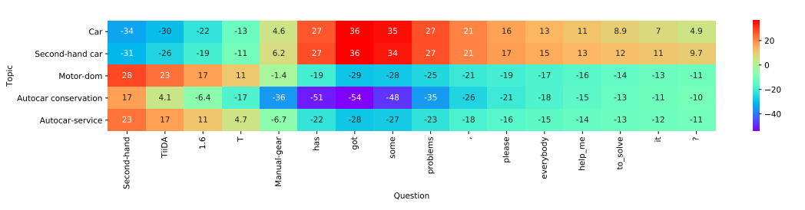
Model
[EXAM model]
#1 #2 #3
The
movie
is
funny
.
Interaction
The interaction mechanism allows you to explicitly interpretation
the relationship between words and classes.

Slide 26
Model
[EXAM model]
#1 #2 #3
The
movie
is
funny
.
Interaction
The interaction mechanism allows you to explicitly interpretation
the relationship between words and classes.

Slide 27
Experiment
[Data Summary]
Data | Class | Average Lengths | Train Samples | Test Samples | Tasks
Amz. P. | 2 | 91 | 3,600,000 | 400,000 | Sentiment Analysis
Amz. F. | 5 | 93 | 3,000,000 | 650,000 | Sentiment Analysis
AG | 4 | 44 | 120,000 | 7,600 | News Classification
Yah. A. | 10 | 112 | 1,400,000 | 60,000 | Question Answer
DBP | 14 | 55 | 560,000 | 70,000 | Ontology Extraction
Kanshan-Cup Dataset | 1999 | 13 | 3,000,000 | 20,000 | Question Answer
Zhihu Dataset | 1999 | ㆍ | 3,000,000 | 300,000 | Question Answer
Notes:
자세한 Description을 쓸것 / 접근가능한지 아닌지

Slide 28
Experiment
[Hyperparameter Summary]
 | Paper (Open Source) | Basic | Mine
Embedding_size | 128 | 128 | 128
Batch | 16 | 256 | 256
Learning rate | 0.0001 | 0.0001 | 0.0001
Region Size | 7 | 7 | 7
Epoch | 20 | 10 | 10
Word Embedding | - | Random | Uniform(-0.01,0.01)
Class Embedding | - | Random | Uniform(-0.01,0.01)
Aggregation Layer | - | Random | Xavier
Dropout | X (but recommended use) | X | O
L2norm | X (but recommended use) | X | 1e-8
Notes:
자세한 Description을 쓸것 / 접근가능한지 아닌지

Slide 29
Experiment
[Hyperparameter Summary]
 | Paper (Open Source) | Basic | Mine
Embedding_size | 128 | 128 | 128
Batch | 16 | 256 | 256
Learning rate | 0.0001 | 0.0001 | 0.0001
Region Size | 7 | 7 | 7
Epoch | 20 | 10 | 10
Word Embedding | - | Random | Uniform(-0.01,0.01)
Class Embedding | - | Random | Uniform(-0.01,0.01)
Aggregation Layer | - | Random | Xavier
Dropout | X (but recommended use) | X | O
L2norm | X (but recommended use) | X | 1e-8
Notes:
자세한 Description을 쓸것 / 접근가능한지 아닌지

Slide 30
Experiment
[Hyperparameter Experiment]
 | Setup | Rate(%) | Accuracy(%)
Basic | - | - | 88.9%
Aggregation | Random->Xavier | +2.1% | 91.0%
Embedding | Random->Uniform | +1.1% | 92.1%
Dropout | X -> O | +0.3% | 92.4%
L2norm | X -> 1e-8 | +0.2% | 92.6%
Notes:
자세한 Description을 쓸것 / 접근가능한지 아닌지

Slide 31
Experiment
[Hyperparameter Experiment]
 | Setup | Rate(%) | Accuracy(%)
Basic | - | - | 88.9%
Aggregation | Random->Xavier | +2.1% | 91.0%
Embedding | Random->Uniform | +1.1% | 92.1%
Dropout | X -> O | +0.3% | 92.4%
L2norm | X -> 1e-8 | +0.2% | 92.6%
Notes:
자세한 Description을 쓸것 / 접근가능한지 아닌지

Slide 32
Experiment
[Hyperparameter Experiment]
 | Setup | Rate(%) | Accuracy(%)
Basic | - | - | 88.9%
Aggregation | Random->Xavier | +2.1% | 91.0%
Embedding | Random->Uniform | +1.1% | 92.1%
Dropout | X -> O | +0.3% | 92.4%
L2norm | X -> 1e-8 | +0.2% | 92.6%
Notes:
자세한 Description을 쓸것 / 접근가능한지 아닌지

Slide 33
Experiment
[Experiment Results]
 | Amz. P. | Amz. F. | AG | Yah. A. | DBP
EXAM | 95.5 | 61.9 | 93.0 | 74.8 | 99.0
(Reproduce) | 93.8 | 57.8 | 92.6 | 74.8 | 99.0
EXAM_encoder | 95.1 | 60.9 | 92.8 | 73.1 | 98.9
(Reproduce) | 93.2 | 57.4 | 92.4 | 74.0 | 98.7
Notes:
자세한 Description을 쓸것 / 접근가능한지 아닌지

Slide 34
Experiment
[Experiment Results]
 | Amz. P. | Amz. F. | AG | Yah. A. | DBP
EXAM | 95.5 | 61.9 | 93.0 | 74.8 | 99.0
(Reproduce) | 93.8 | 57.8 | 92.6 | 74.8 | 99.0
EXAM_encoder | 95.1 | 60.9 | 92.8 | 73.1 | 98.9
(Reproduce) | 93.2 | 57.4 | 92.4 | 74.0 | 98.7
Notes:
자세한 Description을 쓸것 / 접근가능한지 아닌지

Slide 35
Experiment
[Experiment Results]
 | Amz. P. | Amz. F. | AG | Yah. A. | DBP
EXAM | 95.5 | 61.9 | 93.0 | 74.8 | 99.0
(Reproduce) | 93.8 | 57.8 | 92.6 | 74.8 | 99.0
EXAM_encoder | 95.1 | 60.9 | 92.8 | 73.1 | 98.9
(Reproduce) | 93.2 | 57.4 | 92.4 | 74.0 | 98.7
Notes:
자세한 Description을 쓸것 / 접근가능한지 아닌지

Slide 36
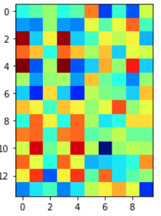
Experiment
[Visualization]
Company
EducationalInstitution
Artist
Althlete
OfficeHolder
MeanOfTransportation
Building
NaturalPlace
Village
Animal
Plant
Album
Film
WrittenWork
Sentence :
Mahru Orostachys ( Mahru Orostachys Indonesian directed tells Review ii
Notes:
자세한 Description을 쓸것 / 접근가능한지 아닌지

Slide 37
Experiment
[Visualization]
Company
EducationalInstitution
Artist
Althlete
OfficeHolder
MeanOfTransportation
Building
NaturalPlace
Village
Animal
Plant
Album
Film
WrittenWork
Sentence :
Mahru Orostachys ( Mahru Orostachys Indonesian directed tells Review ii
Notes:
자세한 Description을 쓸것 / 접근가능한지 아닌지

Slide 38
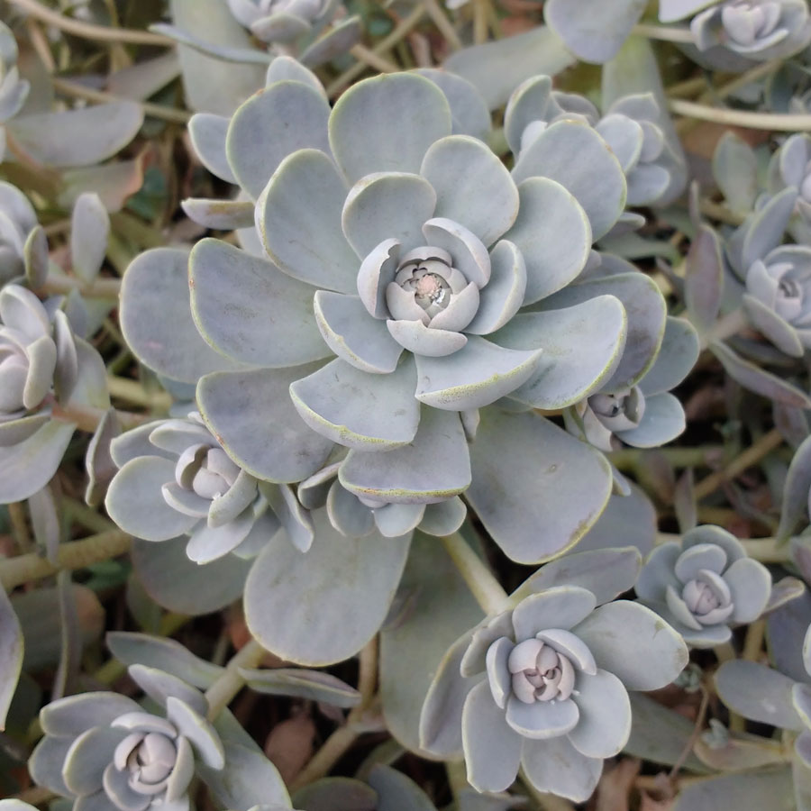
Experiment
[Visualization]
< Orostachys >
Company
EducationalInstitution
Artist
Althlete
OfficeHolder
MeanOfTransportation
Building
NaturalPlace
Village
Animal
Plant
Album
Film
WrittenWork
Sentence :
Mahru Orostachys ( Mahru Orostachys Indonesian directed tells Review ii
Notes:
자세한 Description을 쓸것 / 접근가능한지 아닌지

Slide 39
Experiment
[Visualization]
< Orostachys >
Company
EducationalInstitution
Artist
Althlete
OfficeHolder
MeanOfTransportation
Building
NaturalPlace
Village
Animal
Plant
Album
Film
WrittenWork
We can interpret the relationship
between the two !
Sentence :
Mahru Orostachys ( Mahru Orostachys Indonesian directed tells Review ii
Notes:
자세한 Description을 쓸것 / 접근가능한지 아닌지

Slide 40
Experiment
[Additional Experiment : EXAM Attention]
The
movie
is
funny
.
#1 #2 #3
0.1
0.0
0.3
The
movie
0.2
0.5
0.6
is
softmax
0.0
0.1
0.1
funny
.
0.7
0.2
0.0
#1 #2 #3
0.0
0.2
0.0

Slide 41
Experiment
[Additional Experiment : EXAM Attention]
Attention about #1
Attention about #2
Attention about #3
The
movie
X 0.1
X 0.0
X 0.3
+
+
+
is
X 0.2
X 0.5
X 0.6
funny
+
+
+
X 0.0
X 0.1
X 0.1
.
+
+
+
X 0.7
X 0.2
X 0.0
0.3
+
+
+
0.1
0.0
X 0.0
X 0.2
X 0.0
0.2
0.5
0.6
0.0
0.1
0.1
< #1 > text representation
0.7
0.2
0.0
< #2 > text representation
0.0
0.2
0.0
< #3 > text representation

Slide 42
Experiment
[Experiment Results]
 | Amz. P. | Amz. F. | AG | Yah. A. | DBP
EXAM (Paper) | 95.5 | 61.9 | 93.0 | 74.8 | 99.0
(Reproduce) | 93.8 | 57.8 | 92.6 | 74.8 | 99.0
EXAM_Attention | ㆍ | ㆍ | ㆍ | ㆍ | ㆍ
(Produce) | 93.5 | 57.7 | 92.3 | 74.4 | 99.0
Notes:
자세한 Description을 쓸것 / 접근가능한지 아닌지

Slide 43
Experiment
[Experiment Results]
 | Amz. P. | Amz. F. | AG | Yah. A. | DBP
EXAM (Paper) | 95.5 | 61.9 | 93.0 | 74.8 | 99.0
(Reproduce) | 93.8 | 57.8 | 92.6 | 74.8 | 99.0
EXAM_Attention | ㆍ | ㆍ | ㆍ | ㆍ | ㆍ
(Produce) | 93.5 | 57.7 | 92.3 | 74.4 | 99.0
Notes:
자세한 Description을 쓸것 / 접근가능한지 아닌지

Slide 44
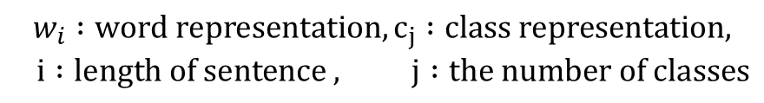
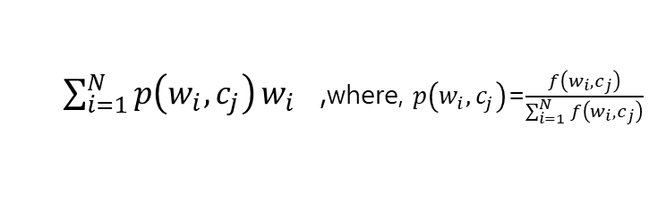
Experiment
[Additional Experiment : EXAM Attention]
$$w_{i} :word representation, c_{j} :class representation,$$
$$i :length of sentence , j :the number of classes$$
#1 #2 #3
Attention about #1
Attention about #2
Attention about #3
The
X 0.1
X 0.0
X 0.3
+
+
+
movie
X 0.2
X 0.5
X 0.6
+
+
+
is
X 0.0
X 0.1
X 0.1
+
+
+
funny
X 0.7
X 0.2
X 0.0
+
+
+
.
X 0.0
X 0.2
X 0.0
Interaction
[$f\left(w_{1}, c_{j}\right)$; $f\left(w_{2}, c_{j}\right);〮〮〮 ;f\left(w_{N}, c_{j}\right)$] ,where $f\left(w_{i}, c_{j}\right)$=$w_{i}ㆍc_{j}$
$\sum_{i=1}^{N}{p\left(w_{i}, c_{j}\right)}w_{i}$ ,where, $p\left(w_{i}, c_{j}\right)$=$\frac{f\left(w_{i}, c_{j}\right)}{\sum_{i=1}^{N}{f\left(w_{i}, c_{j}\right)}}$

Slide 45

Experiment
[Additional Experiment : EXAM Attention]
EXAM : [$f\left(w_{N}, c_{j}\right)$; $f\left(w_{N}, c_{j}\right);〮〮〮 ;f\left(w_{N}, c_{j}\right)$]
Each has a unique value between the class and the word.

Slide 46
Experiment
[Additional Experiment : EXAM Attention]
EXAM : [$f\left(w_{N}, c_{j}\right)$; $f\left(w_{N}, c_{j}\right);〮〮〮 ;f\left(w_{N}, c_{j}\right)$]
Each has a unique value between the class and the word.
#1 #2 #3
Class :
#1 #2 #3
The
movie
Sentence :
The movie is funny .
is
funny
.
Interaction

Slide 47
Experiment
[Additional Experiment : EXAM Attention]
EXAM : [$f\left(w_{N}, c_{j}\right)$; $f\left(w_{N}, c_{j}\right);〮〮〮 ;f\left(w_{N}, c_{j}\right)$]
Each has a unique value between the class and the word.
#1 #2 #3
Class :
#1 #2 #3
The
movie
Sentence :
The movie is funny .
is
funny
.
Interaction

Slide 48
Experiment
[Additional Experiment : EXAM Attention]
EXAM : [$f\left(w_{N}, c_{j}\right)$; $f\left(w_{N}, c_{j}\right);〮〮〮 ;f\left(w_{N}, c_{j}\right)$]
Each has a unique value between the class and the word.
#1 #2 #3
Class :
#1 #2 #3
The
movie
Sentence :
The movie is funny .
is
funny
.
Interaction

Slide 49
Experiment
[Additional Experiment : EXAM Attention]
EXAM : [$f\left(w_{N}, c_{j}\right)$; $f\left(w_{N}, c_{j}\right);〮〮〮 ;f\left(w_{N}, c_{j}\right)$]
Each has a unique value between the class and the word.
#1 #2 #3
Class :
#1 #2 #3
The
movie
Sentence :
The movie is funny .
is
funny
.
Interaction

Slide 50
Experiment
[Additional Experiment : EXAM Attention]
EXAM : [$f\left(w_{N}, c_{j}\right)$; $f\left(w_{N}, c_{j}\right);〮〮〮 ;f\left(w_{N}, c_{j}\right)$]
Each has a unique value between the class and the word.
#1 #2 #3
Class :
#1 #2 #3
The
movie
Sentence :
The movie is funny .
is
funny
.
Interaction

Slide 51
Experiment
[Additional Experiment : EXAM Attention]
EXAM : [$f\left(w_{N}, c_{j}\right)$; $f\left(w_{N}, c_{j}\right);〮〮〮 ;f\left(w_{N}, c_{j}\right)$]
Each has a unique value between the class and the word.
#1 #2 #3
Class :
#1 #2 #3
The
movie
Sentence :
The movie is funny .
is
funny
.
Interaction

Slide 52
Experiment
[Additional Experiment : EXAM Attention]
EXAM : [$f\left(w_{N}, c_{j}\right)$; $f\left(w_{N}, c_{j}\right);〮〮〮 ;f\left(w_{N}, c_{j}\right)$]
Each has a unique value between the class and the word
#1 #2 #3
Class :
#1 #2 #3
The
movie
Sentence :
The movie is funny .
is
funny
.
Interaction

Slide 53
Experiment
[Additional Experiment : EXAM Attention]
EXAM : [$f\left(w_{N}, c_{j}\right)$; $f\left(w_{N}, c_{j}\right);〮〮〮 ;f\left(w_{N}, c_{j}\right)$]
Each has a unique value between the class and the word.

Slide 54
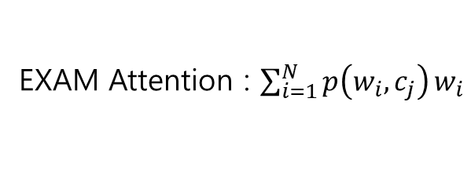
Experiment
[Additional Experiment : EXAM Attention]
EXAM : [$f\left(w_{N}, c_{j}\right)$; $f\left(w_{N}, c_{j}\right);〮〮〮 ;f\left(w_{N}, c_{j}\right)$]
Each has a unique value between the class and the word.
EXAM Attention : $\sum_{i=1}^{N}{p\left(w_{i}, c_{j}\right)}w_{i}$
Attention reflects the importance of each word in a sentence.

Slide 55
Experiment
[Additional Experiment : EXAM Attention]
EXAM : [$f\left(w_{N}, c_{j}\right)$; $f\left(w_{N}, c_{j}\right);〮〮〮 ;f\left(w_{N}, c_{j}\right)$]
Each has a unique value between the class and the word.
EXAM Attention : $\sum_{i=1}^{N}{p\left(w_{i}, c_{j}\right)}w_{i}$
Attention reflects the importance of each word in a sentence.
Class :
#1 #2 #3
Attention about #1
Attention about #2
Attention about #3
X 0.1
+
X 0.0
+
X 0.3
+
X 0.2
X 0.5
X 0.6
+
X 0.0
+
X 0.1
+
X 0.1
Sentence :
+
+
X 0.2
+
X 0.0
The movie is funny .
+
X 0.7
+
+
X 0.0
X 0.2
X 0.0

Slide 56
Experiment
[Additional Experiment : EXAM Attention]
EXAM : [$f\left(w_{N}, c_{j}\right)$; $f\left(w_{N}, c_{j}\right);〮〮〮 ;f\left(w_{N}, c_{j}\right)$]
Each has a unique value between the class and the word.
EXAM Attention : $\sum_{i=1}^{N}{p\left(w_{i}, c_{j}\right)}w_{i}$
Attention reflects the importance of each word in a sentence.
Class :
#1 #2 #3
Attention about #1
Attention about #2
Attention about #3
X 0.1
+
X 0.0
+
X 0.3
+
X 0.2
X 0.5
X 0.6
+
X 0.0
+
X 0.1
+
X 0.1
Sentence :
+
+
X 0.2
+
X 0.0
The movie is funny .
+
X 0.7
+
+
X 0.0
X 0.2
X 0.0

Slide 57
Experiment
[Additional Experiment : EXAM Attention]
EXAM : [$f\left(w_{N}, c_{j}\right)$; $f\left(w_{N}, c_{j}\right);〮〮〮 ;f\left(w_{N}, c_{j}\right)$]
Each has a unique value between the class and the word.
EXAM Attention : $\sum_{i=1}^{N}{p\left(w_{i}, c_{j}\right)}w_{i}$
Attention reflects the importance of each word in a sentence.
Class :
#1 #2 #3
Attention about #1
Attention about #2
Attention about #3
X 0.1
+
X 0.0
+
X 0.3
+
X 0.2
X 0.5
X 0.6
+
X 0.0
+
X 0.1
+
X 0.1
Sentence :
+
+
X 0.2
+
X 0.0
The movie is funny .
+
X 0.7
+
+
X 0.0
X 0.2
X 0.0

Slide 58
Experiment
[Additional Experiment : EXAM Attention]
EXAM : [$f\left(w_{N}, c_{j}\right)$; $f\left(w_{N}, c_{j}\right);〮〮〮 ;f\left(w_{N}, c_{j}\right)$]
Each has a unique value between the class and the word.
EXAM Attention : $\sum_{i=1}^{N}{p\left(w_{i}, c_{j}\right)}w_{i}$
Attention reflects the importance of each word in a sentence.
Class :
#1 #2 #3
Can’t evaluate which one is better,
Sentence :
The movie is funny .
Notes:
어떤 것이 더 좋을지는 평가할 수 없지만 단어 자체에 집중하고싶다면 전자를 문장 전체에서의 단어의 역할에 집중하고싶다면 후자를 선택하는 것이 옳을 것이다
You can't evaluate which one is better, but if you want to focus on the word itself, you can choose the latter if you want to focus on the role of the word in the whole sentence.

Slide 59
Plan
[Plan & Progress]
Experiment further by adjusting hyperparameters for amazon data.
Multi-Label implementation.
Reinterpretation of implementation-based papers.
0%
50%
100%
Start
Architecture
complete
Multi-Class
complete
Multi-Label
complete
Hyperparameter
experiment
Hyperparameter
experiment
Implementation-based
Interpretation of the paper
Notes:
자세한 Description을 쓸것 / 접근가능한지 아닌지

Slide 60
Q&A
Q & A
Notes:
FastText 수정사항 embedding
논문두개합치기
해싱 어떻게든
실험은 분리, / 정확한설명덧붙어ㅕ서
Task 각각에 대해 간단하게

Slide 61
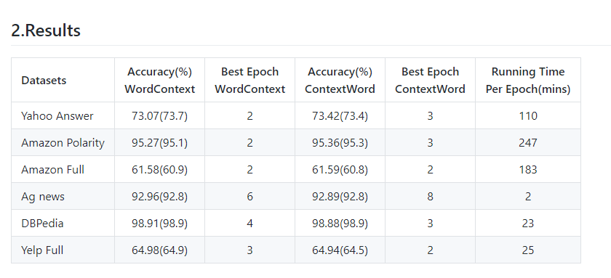
Q&A
Notes:
FastText 수정사항 embedding
논문두개합치기
해싱 어떻게든
실험은 분리, / 정확한설명덧붙어ㅕ서
Task 각각에 대해 간단하게

Slide 62
Model
[EXAM model]
Word representation
The
SUM
movie
Text representation
is
The movie is funny .
funny
.

Slide 63
Model
[EXAM model]
Word representation
The
SUM
movie
Text representation
is
The movie is funny .
funny
Express textual content
simply by summing words.
.

Slide 64
Model
[EXAM model]
Word representation
The
SUM
movie
Text representation
is
The movie is funny .
funny
Express textual content
simply by summing words.
.
Classified but difficult to interpret
relationship with class.

Slide 65
Model
[EXAM model]
The movie is funny .
Compress information into one representation
Keep each information
#1 #2 #3
The
movie
is
funny
.
Interaction

Slide 66
Experiment
[Running Time]
- Per 1 epoch
 | Paper / batch 16 | Mine / batch 16 | Mine / batch 256
Amz. P. | - | 7h | 39m
Amz. F. | - | 7h | 37m
AG | - | 5m30 | 42s
DBP | - | 1h15 | 7m
Yah. A. | - | 4h06 | 35m
Experiment environment : GPU Tesla K 80 (Google Colab)
Notes:
자세한 Description을 쓸것 / 접근가능한지 아닌지

Slide 67
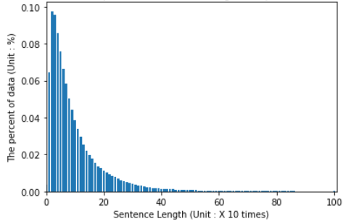
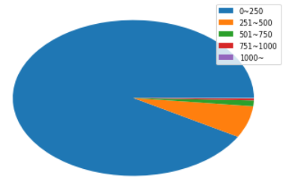
Experiment
[Running Time]
- Yahoo! Answers
Distribution of sentence length
Ratio of sentence length
Notes:
자세한 Description을 쓸것 / 접근가능한지 아닌지

Slide 68
Experiment
[Running Time]
- Yahoo! Answers
Distribution of sentence length
Ratio of sentence length
1024
The paper uses a maximum sentence length of 1024.
Notes:
자세한 Description을 쓸것 / 접근가능한지 아닌지

Slide 69
Experiment
[Running Time]
- Yahoo! Answers
Distribution of sentence length
Ratio of sentence length
512
The paper uses a maximum sentence length of 1024.
However, when the length distribution is referred to,
the data can be analyzed more efficiently.
Notes:
자세한 Description을 쓸것 / 접근가능한지 아닌지

Slide 70
Experiment
[Running Time]
- Per 1 epoch
 | Paper / batch 16 | Mine / batch 16 | Mine / batch 256
Amz. P. | - | 7h | 39m
Amz. F. | - | 7h | 37m
AG | - | 5m30 | 42s
DBP | - | 1h15 | 7m
Yah. A. | - | 4h06 | 35m
Experiment environment : GPU Tesla K 80 (Google Colab)
23m
Notes:
성능은 유지하지만 더 1.5배 더 빠르다.

Slide 71
Experiment
[Additional Experiment : EXAM Attention]
$$w_{i} :word representation, c_{j} :class representation,$$
$$i :length of sentence , j :the number of classes$$

Slide 72
Experiment
[Additional Experiment : EXAM Attention]
$$w_{i} :word representation, c_{j} :class representation,$$
$$i :length of sentence , j :the number of classes$$
#1 #2 #3
The
movie
is
funny
.
Interaction
[$f\left(w_{1}, c_{j}\right)$; $f\left(w_{2}, c_{j}\right);〮〮〮 ;f\left(w_{N}, c_{j}\right)$] ,where $f\left(w_{i}, c_{j}\right)$=$w_{i}ㆍc_{j}$
Notes:
스코어 값은 범위가 –INF, INF라 크게 줄경우 크게 업데이트 될것임

Slide 73
Experiment
[Additional Experiment : EXAM Attention]
$$w_{i} :word representation, c_{j} :class representation,$$
$$i :length of sentence , j :the number of classes$$
#1 #2 #3
Attention about #1
Attention about #2
Attention about #3
The
X 0.1
X 0.0
X 0.3
+
+
+
movie
X 0.2
X 0.5
X 0.6
+
+
+
is
X 0.0
X 0.1
X 0.1
+
+
+
funny
X 0.7
X 0.2
X 0.0
+
+
+
.
X 0.0
X 0.2
X 0.0
Interaction
[$f\left(w_{1}, c_{j}\right)$; $f\left(w_{2}, c_{j}\right);〮〮〮 ;f\left(w_{N}, c_{j}\right)$] ,where $f\left(w_{i}, c_{j}\right)$=$w_{i}ㆍc_{j}$
$\sum_{i=1}^{N}{p\left(w_{i}, c_{j}\right)}w_{i}$ ,where, $p\left(w_{i}, c_{j}\right)$=$\frac{f\left(w_{i}, c_{j}\right)}{\sum_{i=1}^{N}{f\left(w_{i}, c_{j}\right)}}$

